Slide 1

CODING WITH
K/V & RIAK
A journey from
prototype to production
3/5/15
Dmitri

Slide 2


Agenda
NoSQL World
What’s Riak
Scaling Up
Prototyping
Dev on K/V
Dev on Riak
Notes:
The first 4 will take about ~35-40 minutes. We’ll then take an intermission to re-up on food and drink. Then the dev heavy logic will be another 35 or so.

Slide 3
Why NoSQL?

Slide 4
“Big Data”

Slide 5
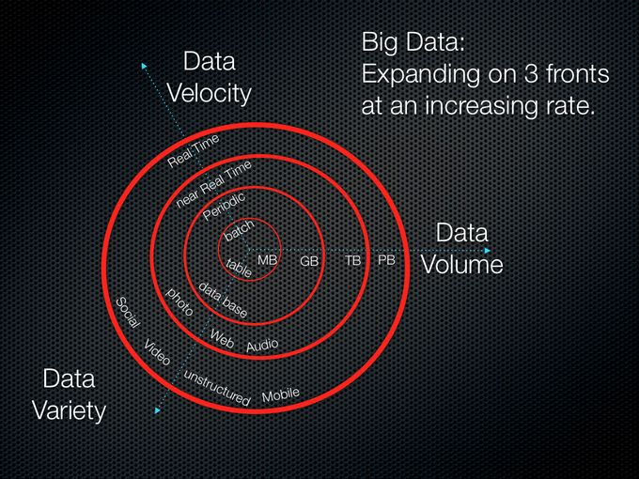
“Big Data”

Slide 6
IoT

Slide 7

IoT
Notes:
A.k.a. “Now everything in your house will need security updates that you will ignore”

Slide 8

“Weather changes, and so must IT.”
Notes:
commented Bryson Koehler, executive vice president and CIO, The Weather Company.
from: http://basho.com/the-weather-company-deploys-basho-riak-for-next-generation-forecast-and-data-services-platform/

Slide 9
So, Why NoSQL?
Scalability
Flexibility
Notes:
Flexibility: don't require a predefined schema (a.k.a. data model) that demands one way to manage data in columns and rows. This gets ever more difficult to change as the database grows
Scalability: runs on clusters. Traditional SQL architecture just not designed to scale like that.

Slide 10

NoSQL Types

Slide 11
Key/Value
Notes:
Examples: Cassandra, DyanmoDB, Azure Table Storage (ATS), Riak, BerkeleyDB.
Give it a key and value, it saves the value
Give it a key, it returns the value
Does not care what the value is
Data modeling reversed – instead of model to view, start w view.
Continuum – complexity of the query planner, vs scaling. YOU are the query planner.

Slide 12
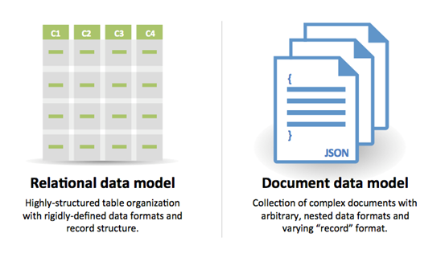
Relation vs Doc
Notes:
Examples: MongoDB, CouchDB

Slide 13
Wide Column
Notes:
instead of storing data in rows, these databases are designed for storing data tables as sections of columns of data, rather than as rows of data
Examples include: HBase, BigTable and HyperTable. (also Cassandra)

Slide 14
Graph
Notes:
Based on graph theory, these databases are designed for data whose relations are well represented as a graph and has elements which are interconnected, with an undetermined number of relations between them.
Examples include: Neo4J and Polyglot.

Slide 15
Time Series
Notes:
Examples: InfluxDB, OpenTSDB
optimized for handling time series data, arrays of numbers indexed by time (a datetime or a datetime range).

Slide 16


Caches
{Special Type}

Slide 17


BASHO DEVELOPS
DISTRIBUTED SYSTEMS
Open Source
Distributed NoSQL Database
Commercial
Distributed NoSQL Database

Slide 18
Key => Value
Notes:
Give it a key and value, it saves the value
Give it a key, it returns the value
Does not care what the value is
Data modeling reversed – instead of model to view, start w view.
Continuum – complexity of the query planner, vs scaling. YOU are the query planner.

Slide 19
Masterless
Notes:
- No SPOF
- No node is special
- One binary, single application
- All nodes accept request

Slide 20
Fault Tolerant
Notes:
- through distribution
- through replication
- enabled by Erlang/OTP
- masterless
- Survives
- Node failure
- Network partition
- Software failures

Slide 21
Highly Available
Notes:
- Any node can serve client requests
- fallbacks are used when nodes are down
- Always accepts reads and writes
- Even in failure states
- Low latency
- Per-request quorums

Slide 22
Queries & Search

Slide 23
Ops-friendly
Notes:
Easy to scale “Just Add a Machine”
Rolling restarts/upgrades – upgrade the OS or Riak with 0 downtime for the cluster as a whole
Lends itself well to config mgmt tools (Ansible / Puppet / Chef)
Monitoring/alerting tools

Slide 24


What makes Riak
unique
Scalability
Low-Latency
High Availability
Fault-Tolerance
Operational Simplicity
Multi-Model
Multi- Datacenter Replication
SNMP & JMX monitoring
24x7 Customer Support
Notes:
What makes Riak unique is it
Handles massive data scale in production
Expands easily and scales for geographically disbursed locations reducing latency for end users
Highly available architecture enables any node to service read or write requests
Integration with Riak CS and Apache Solr provides multi-model support from a single platform

Slide 25
So, NoSQL…

Slide 26

SO WHY SHOULD I CARE
Why use riak

Slide 27
Scale

Slide 28


Scaling Up
why you should care
Fear Success
no more

Slide 29
Scaling Up
why you should care

Slide 30
Scaling Up
from one to many
From laptop to cluster without changing settings

Slide 31
Scaling Up
from one to many
From laptop to cluster without changing settings
^ code
Notes:
No rearchitecting the database (shards, replica sets, etc)

Slide 32
Scaling Up
here’s where it gets.. easy?
Just add a machine
$ dev2/bin/riak-admin cluster join dev1@127.0.0.1
$ dev3/bin/riak-admin cluster join dev1@127.0.0.1
$ dev4/bin/riak-admin cluster join dev1@127.0.0.1
$ dev5/bin/riak-admin cluster join dev1@127.0.0.1

Slide 33
Prototyping

Slide 34
Prototyping
how Riak makes it easier
Schema-less {no updates to table structure}
Store anything {text, images, binaries}
Scaling for free {no rewrites}
Solr: Full text search, geospatial, etc
Notes:
- Schema-less: no updates to table structures, which also means: no required migration of all the previous records that were stored.

Slide 35




Prototyping
Getting going locally
$ apt-get install riak ( Ubuntu, custom apt repo)
OR
$ brew install riak ( Mac OS X )

Slide 36
Prototyping
Getting going
Local
Test/Dev
Prod
=>
=>

Slide 37
K/V Dev

Slide 38
But First… Intermission

Slide 39

K/V Dev
39

Slide 40
Upsides to K/V
Simple
Schema-less
Scales for free
Downsides ?
Well …
Notes:
Dealing with unstructured data.

Slide 41
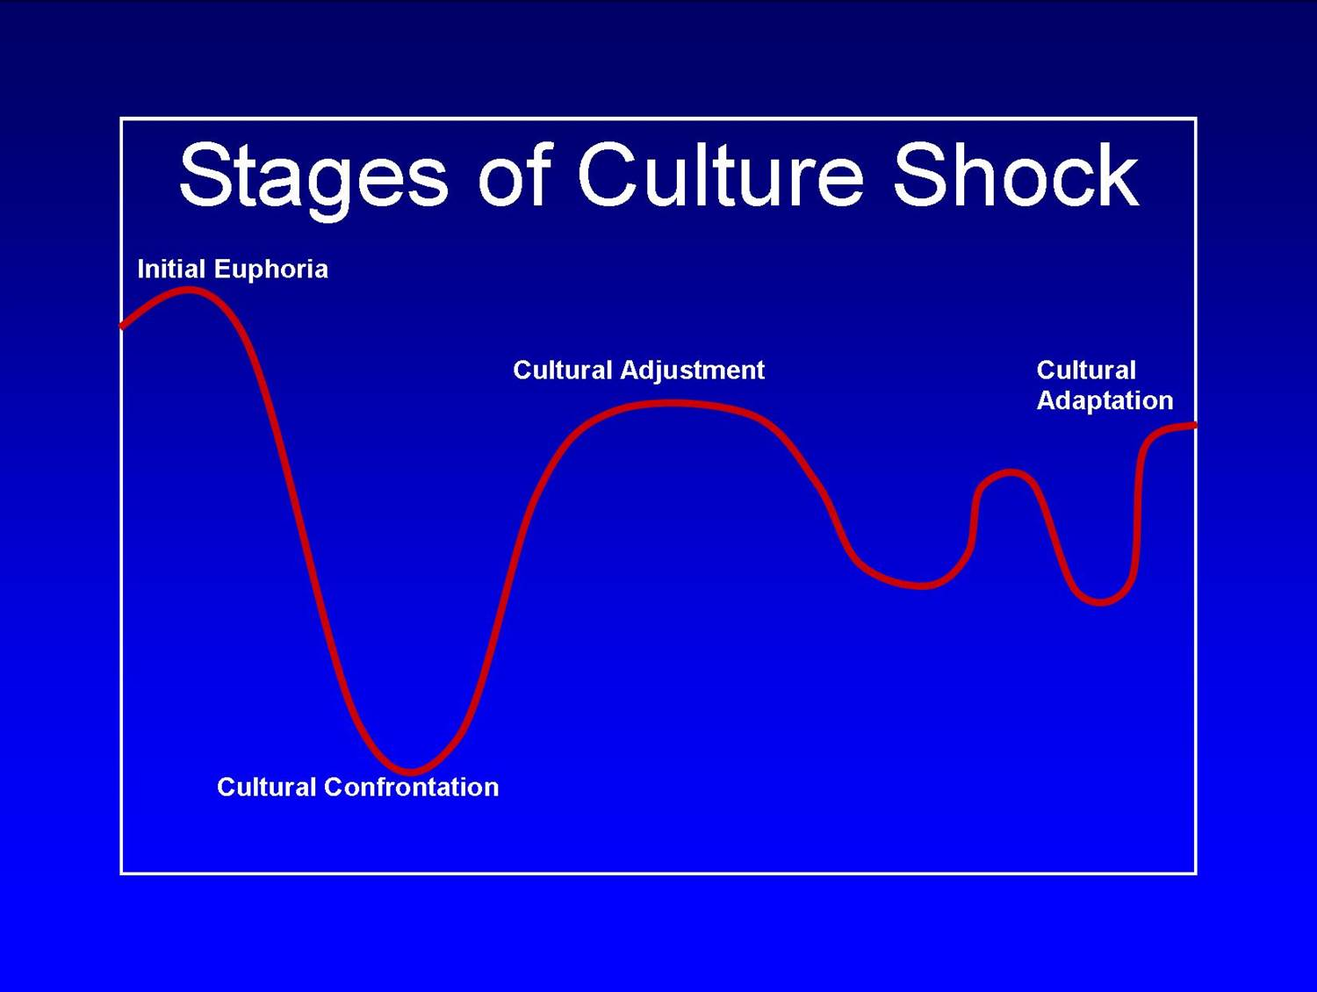
NoSQL ^
Where’s my: Joins?
SELECT * ??
Notes:
Dealing with unstructured data.

Slide 42

Reads & Writes are familiar
Denormalizing is your friend

Slide 43
“Schema-less”
Notes:
Dealing with unstructured data.

Slide 44
Schema-less
But what about schema migrations?
1) Lazy-migration (on load)
2) Last resort: Batch migration (cron jobs, etc)

Slide 45

Think in K/V
it’s a game

Slide 46
Queries
Static
Scheduled
Spontaneous
Dynamic

Slide 47
 | Static | Dynamic
Scheduled
Spontaneous
Notes:
Combined the axis, we have this nice table with four quadrants

Slide 48
 | Static | Dynamic
Scheduled
Spontaneous
Notes:
Scheduled + Static
Eg:
- every 10 minutes, write the log to Riak
- every night at 10pm, compile these reports
Predictable => easy
We can test and compute performance

Slide 49
 | Static | Dynamic
Scheduled | k/v
Spontaneous
Notes:
We know what keys we want to read/write
OR
We know what data we want to extract (report)
OR
We know when to migrate our data

Slide 50
 | Static | Dynamic
Scheduled
Spontaneous
Notes:
Eg:
- web pages
- cache data
No time to think, just fetch or write

Slide 51
 | Static | Dynamic
Scheduled
Spontaneous | k/v
Notes:
High availability and fault tolerance: easy to scale out for traffic burst

Slide 52
 | Static | Dynamic
Scheduled
Spontaneous
Notes:
The query is different depending on runtime input
Eg:
- special reports
- some triggered analysis
- working on unknown set of records
- any text search

Slide 53
 | Static | Dynamic
Scheduled |  | search secondary indexes
Spontaneous
Notes:
These have unbounded APIs
In practice, 2i and search also have unpredictable resource contention

Slide 54
 | Static | Dynamic
Scheduled
Spontaneous
Notes:
We don’t know exactly what request the user or client is going to generate
Dynamic forms

Slide 55
 | Static | Dynamic
Scheduled
Spontaneous |  | relational full-text search graph time series real-time m/r
Notes:
Realtime analysis of data
Anything that internally has a query planner
SQL
Gremlin – graph interface
SAS?
Typically assisted by giving structure to the data – indices

Slide 56
 | Static | Dynamic
Scheduled
Spontaneous |  | ☹
Notes:
What do we do when we have a 4th quadrant use case?

Slide 57

Whenever Possible:
Change the Formula
Notes:
This will blow your mind.

Slide 58
 | Static | Dynamic
Scheduled | k/v | search secondary indexes
Spontaneous | k/v
Notes:
First thing we look for is precalc
Industry isn’t used to this
Contrary to RDBMS experience

Slide 59
 | Static | Dynamic
Scheduled
Spontaneous |  | ☹
Notes:
What if that doesn’t work?

Slide 60

Always Remember:
Hybrid
Solutions

Slide 61
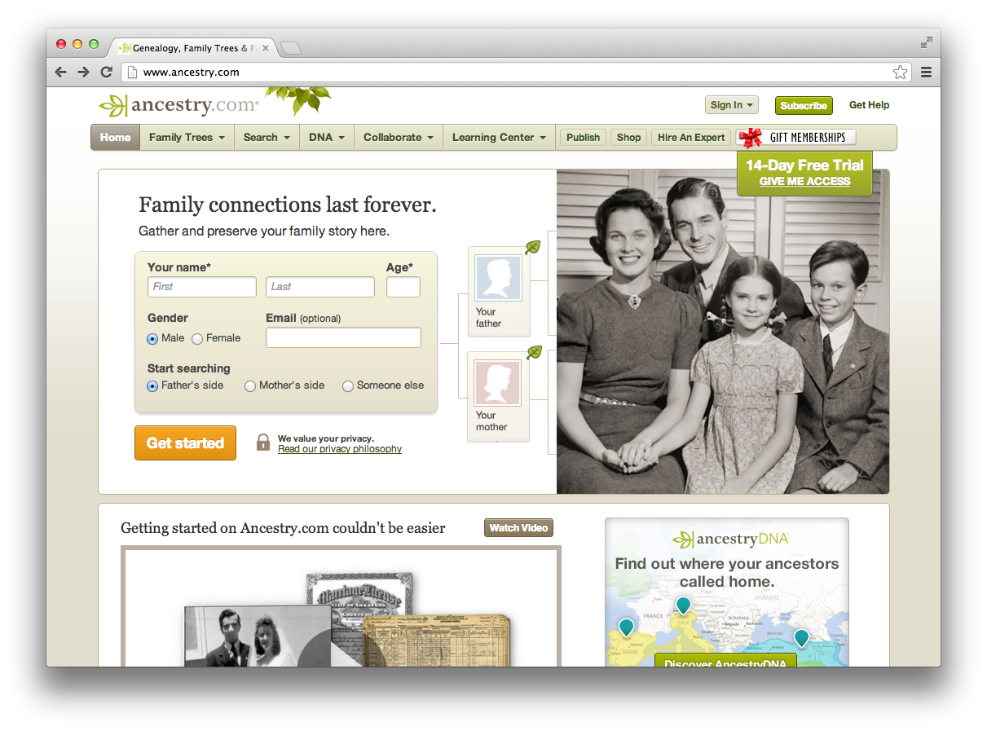
Ancestry.com:
Notes:
Records – store one, get one
Static / spontaneous

Slide 62
 | Static | Dynamic
Scheduled
Spontaneous
Notes:
Practice

Slide 63

Thinkgeek.com:
Notes:
Records – store one, get one
Static / spontaneous

Slide 64
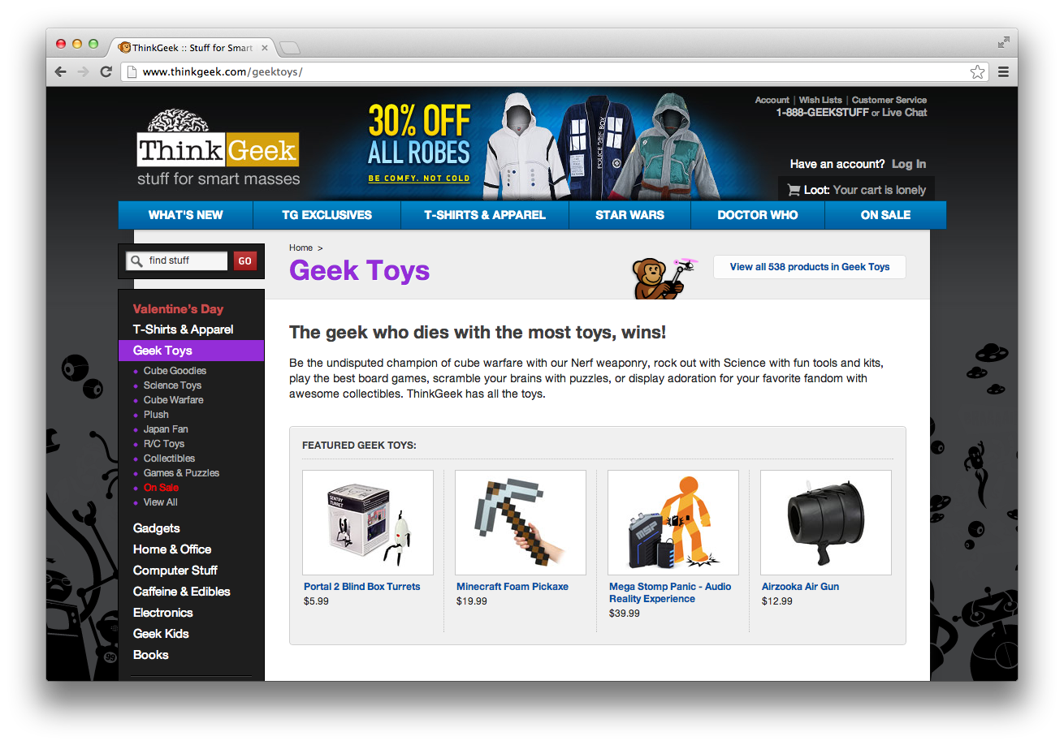
Thinkgeek.com:
Notes:
Records – store one, get one
Static / spontaneous

Slide 65
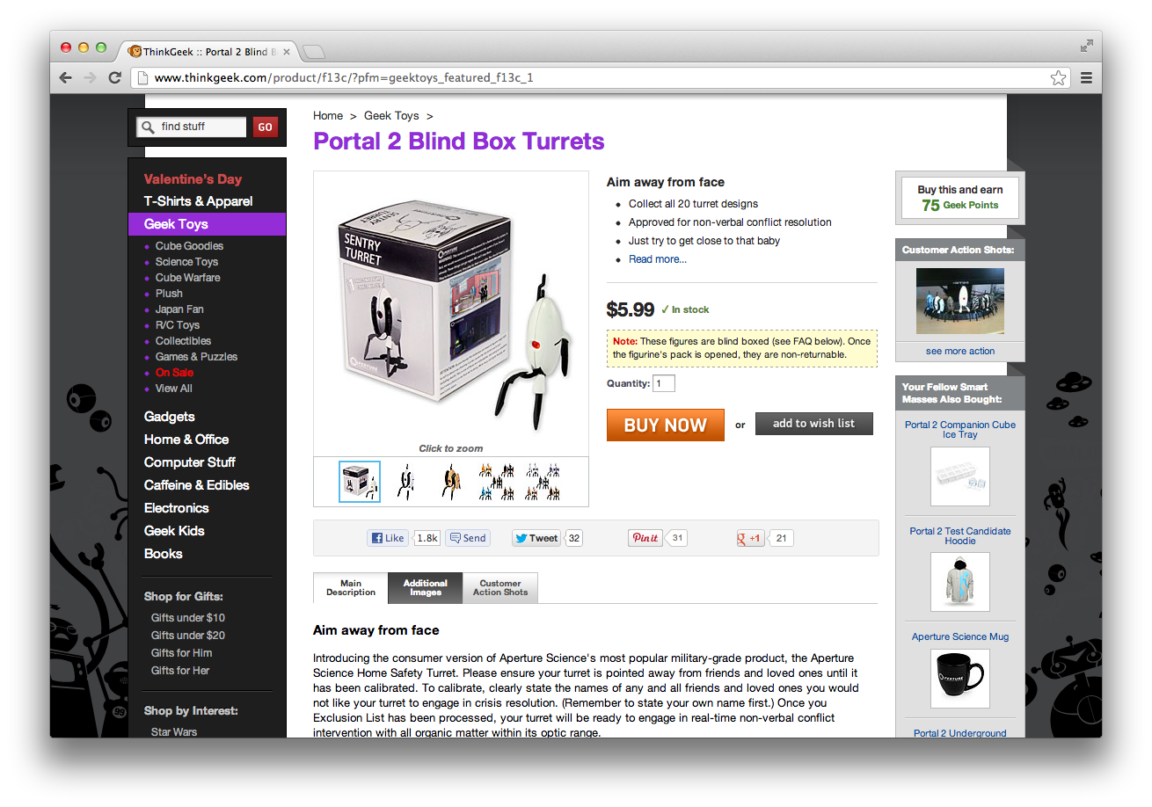
Thinkgeek.com:
Notes:
Records – store one, get one
Static / spontaneous

Slide 66
Thinkgeek.com:
Notes:
Search!

Slide 67
 | Static | Dynamic
Scheduled
Spontaneous
Notes:
Practice

Slide 68
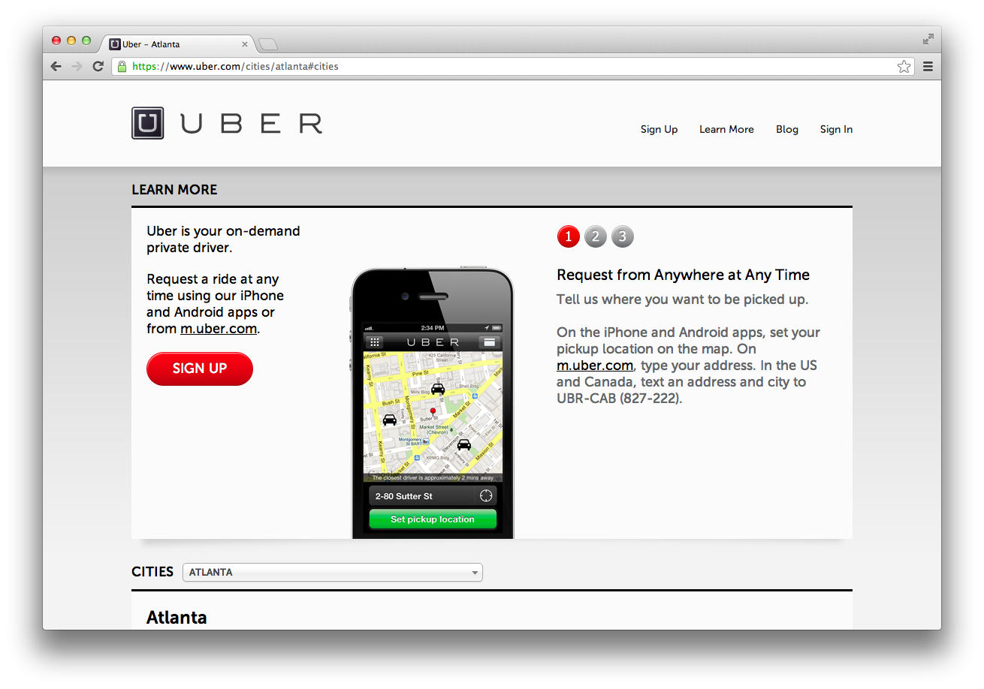
Uber.com:
Notes:
Some sort of geo search
Centroid analysis
Create contract between cars and people
Route analysis
Time series data?

Slide 69
 | Static | Dynamic
Scheduled
Spontaneous
Notes:
Practice

Slide 70
Riak Use Cases
Application Type | Key | Value
Session | User/Session ID | Session Data
Advertising | Campaign ID | Ad Content
Logs | Date | Log File
Sensor | Date, Date/Time | Sensor Updates
User Data | Login, email, UUID | User Attributes
Content | Title, Integer | Text, JSON/XML/HTTP document, images, etc.

Slide 71
Developing for Riak
choose your style
Native APIs: • HTTP(S) • Protocol Buffers
Client Libraries: • Your Favorite Language

Slide 72
HTTP (REST) API
a simple way to store & retrieve

Slide 73
URLs
/buckets/users/keys/user123

Slide 74
Creating Object
$ curl -v http://localhost:8098/buckets/capitals/keys/usa
-X PUT
-H "content-type: text/plain"
-d "Washington D.C.”
* Trying 127.0.0.1... connected
> PUT /buckets/capitals/keys/usa HTTP/1.1
> Content-Type: text/plain
>
< HTTP/1.1 204 No Content

Slide 75
Retrieving Object
$ curl -v http://127.0.0.1:8098/buckets/capitals/keys/usa
Trying 127.0.0.1... Connected
> GET /buckets/capitals/keys/usa HTTP/1.1
< HTTP/1.1 200 OK
< X-Riak-Vclock: a85hYGBgzGDKBVIcR4M2cvvL1tzJYEpkzGNluGw/+QRfFgA=
< Vary: Accept-Encoding
< Server: MochiWeb/1.1 WebMachine/1.9.0 (someone had painted it blue)
< Link: </buckets/capitals>; rel="up"
< Last-Modified: Tue, 24 Jan 2012 14:44:35 GMT
< ETag: "1yAFlUinalK2zNd7LpkOgU”
Washington D.C.

Slide 76








Developing for Riak
Animated
choose your own language
Notes:
ANIMATION – gologo jumps in to talk about community-driven development.

Slide 77


Closing Thoughts
NoSQL offers various optimizations for scale
Riak is an ops friendly K/V store
Scale from from local prototype to dev to prod
Thinking in K/V pairs is different and fun
Notes:
Profile. What do we know about our users?

Slide 78


